Slide 1
OBJECTIVE:
The primary objective of the project is to create an automated and efficient mechanism for monitoring and maintaining optimal growth conditions for crops. This involves integrating various sensors with a microcontroller to collect data on plant growth, soil moisture levels, temperature, and light conditions. The system aims to utilize IoT technology to enable remote monitoring and control, ensuring timely intervention and providing alerts for necessary actions to optimize crop yield.
ABSTRACT:
The Smart Farming System employs a combination of sensors and IoT technology to create an automated monitoring and control system for agricultural purposes. The utilization of sensors like ultrasonic, soil moisture, DHT11, and LDR, interfaced with a microcontroller, enables real-time data collection on plant growth, soil moisture content, temperature, and light intensity. The system's integration with IoT facilitates remote access to monitor and manage these parameters. In case of unfavorable conditions such as low soil moisture, the system triggers alerts through a buzzer, ensuring prompt attention and action to maintain optimal crop growth conditions. This system presents a solution to enhance crop yield by enabling efficient and timely intervention based on accurate environmental data.
INTRODUCTION:
Agriculture forms the backbone of our sustenance, and optimizing crop growth conditions is pivotal for ensuring food security. Traditional farming methods often lack precision in monitoring and maintaining crucial growth parameters for crops. The Smart Farming System Using IoT aims to address this challenge by leveraging sensor technology and IoT connectivity. The system integrates various sensors such as soil moisture, ultrasonic, DHT11, and LDR to gather essential data related to plant growth, soil moisture levels, temperature, and light intensity. These sensors interface with a microcontroller, which processes the data and communicates with an IoT platform. The IoT integration enables farmers to remotely monitor and control the conditions essential for optimal crop growth. Furthermore, the system incorporates a buzzer alert mechanism to notify farmers in real-time of any unfavorable conditions detected, allowing swift corrective actions. This project endeavors to revolutionize traditional farming practices by providing a smart, automated solution for
Effective crop cultivation.

Slide 2
EXISTING SYSTEM:
Farmers would assess plant growth, soil moisture, and environmental conditions through visual inspection and periodic manual measurements. Irrigation scheduling was often based on regular intervals or personal experience rather than precise data-driven decisions. The absence of automated systems led to inefficiencies in resource utilization and delayed responses to changing conditions, impacting crop yield. The integration of advanced sensor technologies, IoT, and automation, as proposed in the Smart Farming System, revolutionized this traditional approach by enabling real-time data collection, remote monitoring, and timely interventions to optimize crop growth.
DISADVANTAGES:
Limited Precision: Manual monitoring and observation lacked precision and real- time accuracy in assessing plant growth, soil moisture, and environmental parameters. This imprecision could lead to suboptimal decision-making.
Resource Inefficiency: Without accurate data, resources such as water for irrigation were often used inefficiently, potentially leading to overwatering or under-watering crops, impacting both yield and resource conservation.
Delayed Responses: Manual monitoring meant delayed responses to changing conditions. By the time issues were identified through visual inspection, corrective actions might have been delayed, impacting crop health.
Reliance on Experience: Decisions were often based on the farmer's experience and intuition rather than on concrete data. This reliance on subjective assessments could lead to inconsistencies and suboptimal outcomes.
Risk of Crop Loss: Inability to promptly identify issues such as low soil moisture levels or other environmental stressors increased the risk of crop loss due to unfavorable conditions going unnoticed.
PROPOSED SYSTEM:
The proposed Smart Farming System integrates various cutting-edge technologies, including soil moisture sensors, ultrasonic sensors, DHT11, LDR, microcontrollers, and IoT. This system aims to automate and optimize crop growth conditions by continuously monitoring crucial parameters such as soil moisture levels, plant growth, ambient light, and temperature. The sensors collect real-time data, which is processed by the microcontroller, enabling timely and precise decision-making. The incorporation of IoT facilitates remote monitoring and control, allowing farmers to access and manage the farm conditions from anywhere. Alerts through a buzzer system promptly notify farmers
conditions, enabling swift interventions and optimizing crop yield.

Slide 3
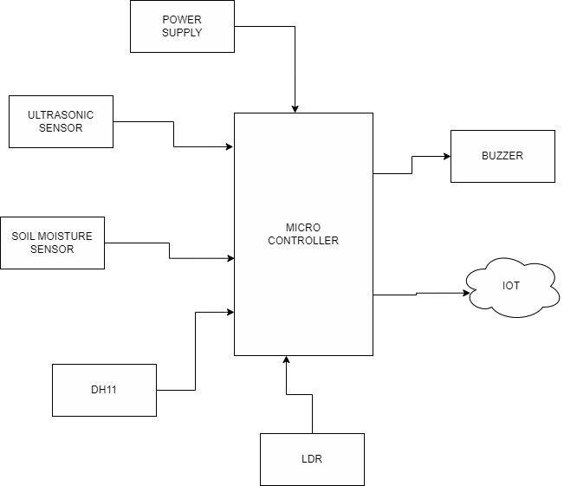
ADVANTAGES:
Precision Agriculture: Integration of advanced sensors ensures precise monitoring of essential parameters like soil moisture, plant growth levels, light intensity, and temperature, allowing for accurate decision-making.
Optimized Resource Management: Real-time data collection enables efficient
resource usage, particularly water for irrigation, reducing wastage and ensuring crops receive the necessary amount of water.
Timely Interventions: Continuous monitoring allows for immediate detection of unfavorable conditions, triggering prompt alerts through the buzzer system. This facilitates timely interventions to mitigate risks and optimize crop health.
Remote Monitoring and Control: IoT integration enables farmers to remotely
monitor and manage farm conditions from anywhere, providing flexibility and ease of management.
Enhanced Crop Yield: By maintaining optimal growth conditions and swiftly addressing issues, the system aims to enhance crop yield, ensuring better productivity
and economic outcomes for farmers.
BLOCK DIAGRAM (HARDWARE)

Slide 4
SOFTWARE REQUIREMENTS:
Arduino ide
Embedded C
IOT
HARDWARE REQUIREMENTS:
Microcontroller
Soil moisture sensor
Ultrasonic sensor
Dht 11
●
●
LDR
Buzzer
CONCLUSION:
The Smart Farming System represents a transformative leap in agricultural practices, leveraging advanced sensor technologies, IoT integration, and automation to optimize crop growth conditions. Through precise monitoring of critical parameters and remote accessibility, it offers a proactive solution to the challenges faced by traditional farming methods. By enabling timely interventions, efficient resource utilization, and data-driven decision-making, this system not only enhances crop yield but also contributes towards sustainable and smarter farming practices. Its potential to revolutionize farm management underscores its significance in ensuring food security while promoting efficiency and sustainability in agriculture.

